Slide 1
CDP Snowflake Overview & Training
Brij Thota

Slide 2
Agenda - Snowflake
1 |  | OPS BI Program Strategic Objectives | Refresher and 2024 objectives
2 |  | Cepheid Data Platform (CDP) | Intro to Snowflake
3 |  | Virtual Hands-on Session | Write your SQL Query in Snowflake
4 |  | Activity Connect to Power BI & Excel | Snowflake view connection

Slide 3
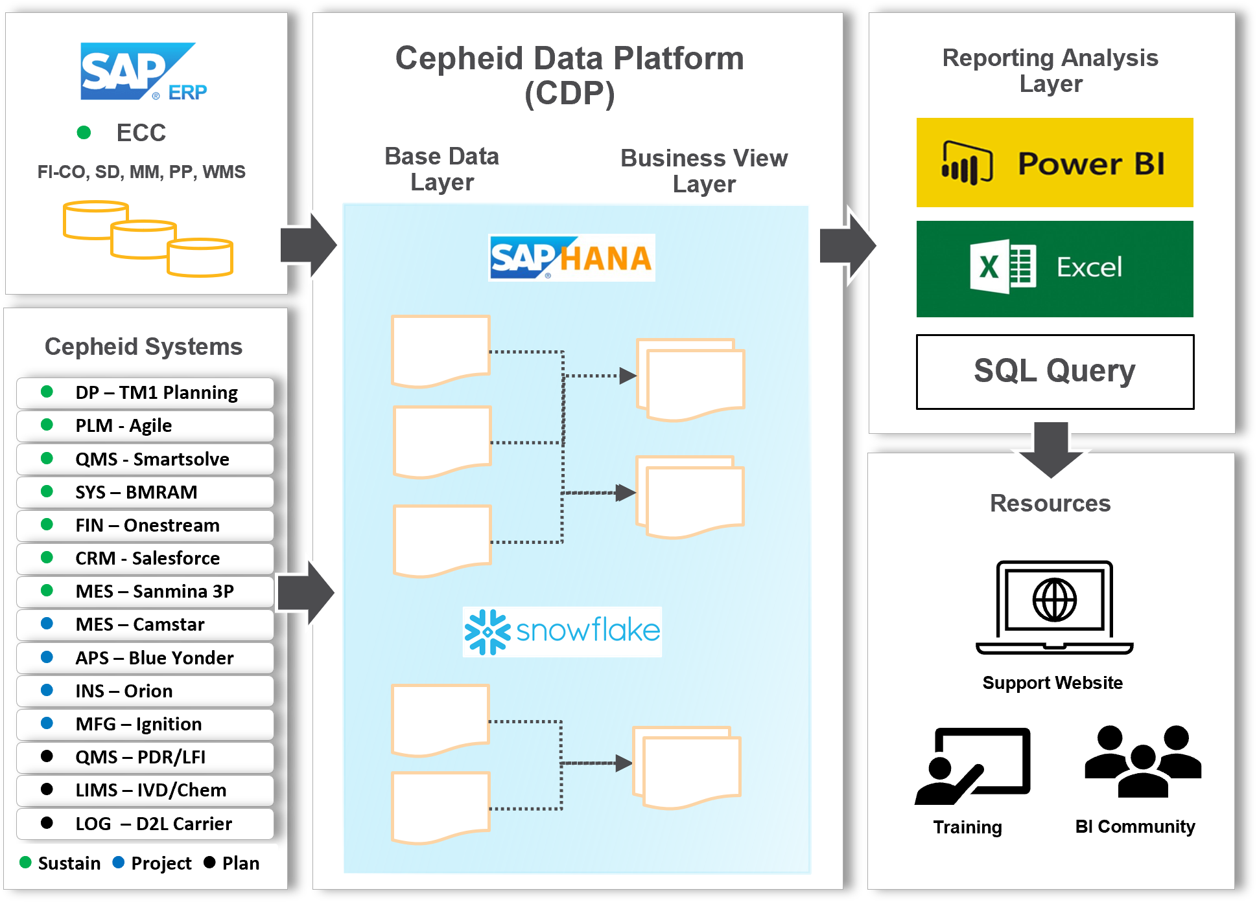
OPS BI Program Objectives
Improve productivity & eliminate waste through Data Democratization & Report Standardization
Leveraging Enterprise Systems - To streamline operations and minimize waste (Muda), it is crucial to align our enterprise systems processes at Gemba using DBS.
Committing to a Data Warehouse - Cepheid's Data Warehouse Platform (CDP) is a collaborative effort with IT to establish a scalable reporting and analytics architecture, ensuring a single source of truth for data
Building a Data Centric Culture – Cepheid Operations is committed to a data driven culture.
Data Governance
Data Platform & Engineering
Advanced Analytics & Reporting

Slide 4
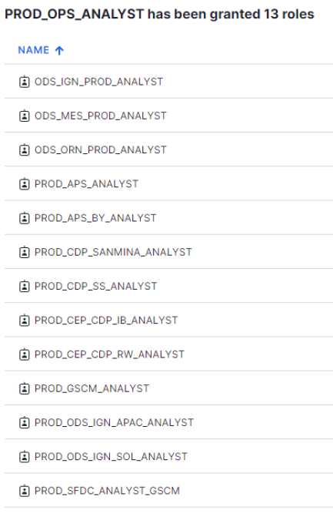
CDP Snowflake Overview
In CDP Snowflake , multiple environments are hosted in the same account. Access is provided by applying for the PROD_OPS_ANALYST role to get access to Production. 1 role will get you access to all current and future OPS datapoints.
User Access Resource Guide (sharepoint.com)
Ignition
(3 Servers)
MES
Orion
APS
Sanmina (Partner)
Salesforce
SmartSolve
GX TS (Q2)
PQ Manager (Q2)
BMRAM (Q2)
Rockwell US Archive
Planning Analytics TM1

Slide 5
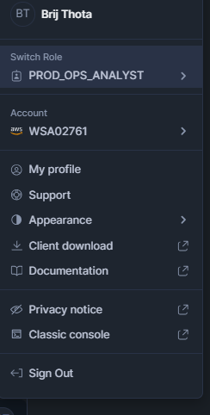
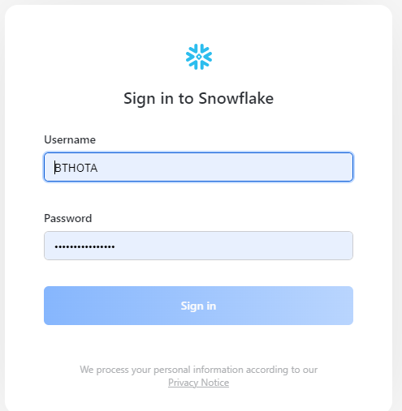
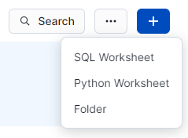
Activity – Explore Snowflake
​​​​​​Snowflake
Go to CEP Snowflake Production
Enter Username and Password
Go to the bottom left and make sure your role is PROD_OPS_ANALYST
Execute your first Query
Click on the + sign, create a new SQL Query
Run All with “CTRL + ENTER”
select * from CEP_MFG_PROD.MFG_QUALITY.SS_NC_RECORDSwhere "Owning Site Code" = 'SOLN' AND "Primary Status" = 'INWORKS' and "Total Days" > 60and "Version" = 'LATEST'order by "Record Number" desc
select * from CEP_MFG_PROD.MFG_QUALITY.SS_NC_RECORDSwhere "Phase" = 'Execute Disposition' and "Material Group 1" = 'Kits'
SQL Cheat Sheet

Slide 6
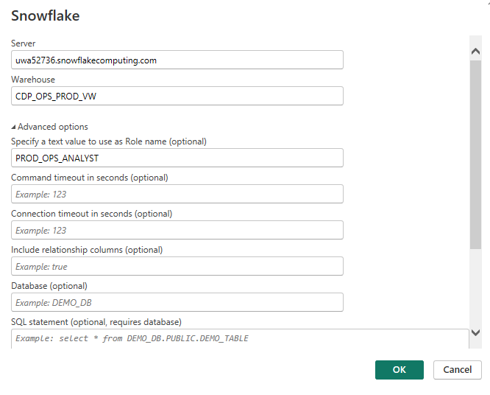
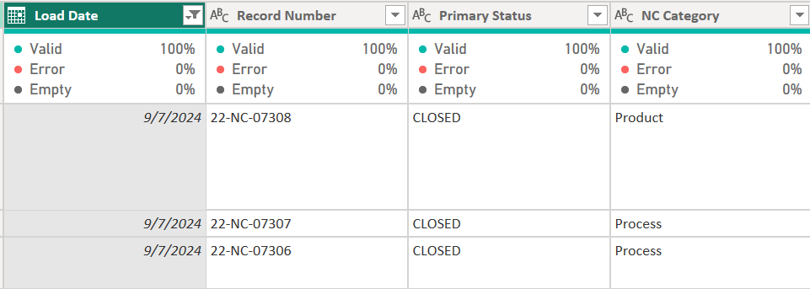
Activity – Connect to Power BI
​​​​​​Once you have Power BI installed, get data from Snowflake
Open Power BI Desktop >> Get Data >> Snowflake
Enter Connection Details
Server: uwa52736.snowflakecomputing.com
Warehouse: CDP_OPS_PROD_VW
Role Name: PROD_OPS_ANALYST
Connect to MFG Quality Views
CEP_MFG_PROD >> MFG_QUALITY >> VIEWS
Import Data
Keep Columns you need (Best Practice)
Filter Version Column to LATEST (Most use cases)

Slide 7
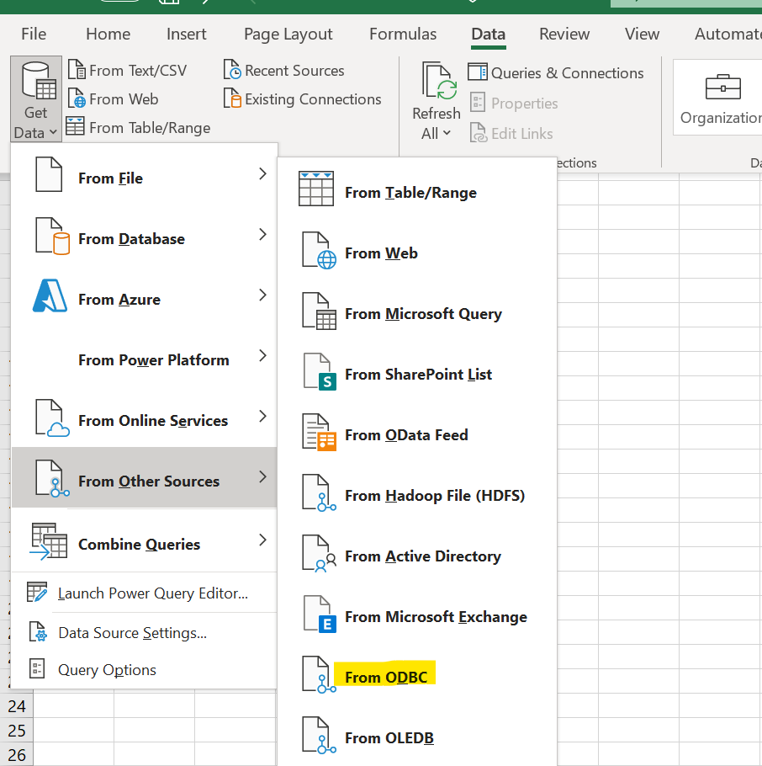
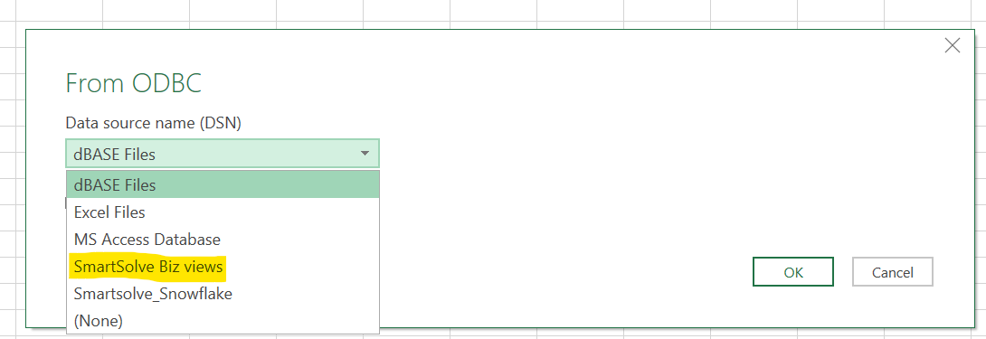
Activity – Connect to Excel
​​​​​​Once you have ODBC Drivers installed, get data from Snowflake
Open Excel >> Get Data >> Other Sources >> From ODBC
Choose the ODBC drivers you named while Installation
Connect to MFG Quality Views
CEP_MFG_PROD >> MFG_QUALITY >> VIEWS
Import Data
Keep Columns you need (Best Practice)
Filter Version column to LATEST (Most use cases)

Slide 8
Learning Resources & BI Community
Snowflake Key Concepts
SQL Queries Tips & Tricks
Get Snowflake Access
Snowflake - User access
Join Office Hours Every Alternate Friday 11 am for any questions
⁠Office Hours - Meeting invite
https://docs.snowflake.com/en/user-guide/intro-key-concepts
SQL Cheat Sheet

Slide 9
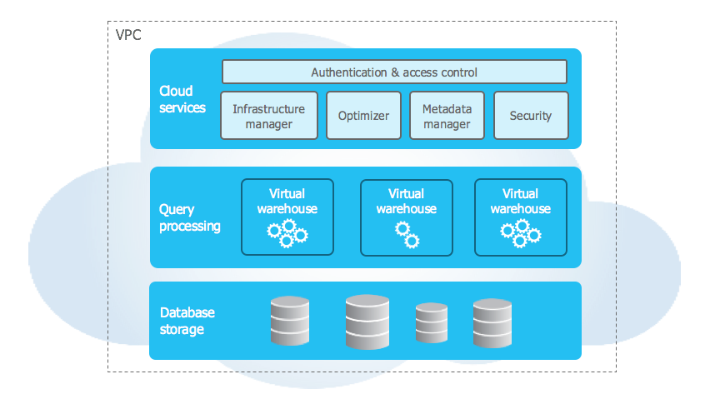
CDP Snowflake Overview
What is so special about Snowflake?
Cloud Services
  Easy access and sharing
  Web based Analysis tool
Query Processing “Warehouse”
  Separate processing layer
  Load balanced compute resources
Database Storage Layer
  Optimized, compressed & columnar structure
  Self Managed organization, metadata, statistics, etc.
https://docs.snowflake.com/en/user-guide/intro-key-concepts

